Slide 1
ATM SECURITY USING FINGER PRINT AND RFID

Slide 2
ABSTRACT:
In this project, we propose a real-time embedded face and finger print recognition system for authentication on ATM devices. The system is implemented on an embedded platform and equipped with rfid and finger print recognition algorithm. The proposed system consists of three hardware modules: Finger print acquisition module, embedded main board, and rfid module.
In this concept at first the RF finger print sensor give finger print also rfid unique id by rfid module given and it gets compared with the database of PIN and finger of the users if it get authorized locker will be opened or else it get unauthorized two buzzer will be enabled for alert.

Slide 3
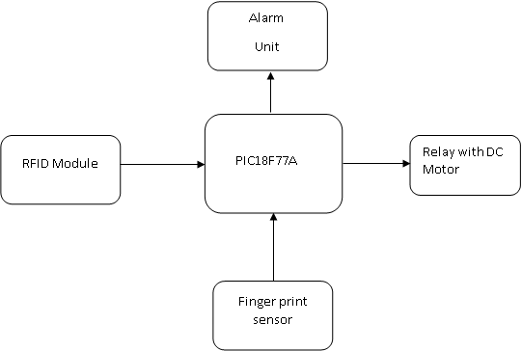
Block Diagram:

Slide 4
Block Diagram Explanation:
Finger Print Sensor and RFID Module DC Motor with relay driver and alarm unit will be connected to PIC Microcontroller.
If the user try to access the locker means first given their finger print as well as the corresponding unique rfid id then the locker will be open, otherwise the alarm unit activated for alert

Slide 5
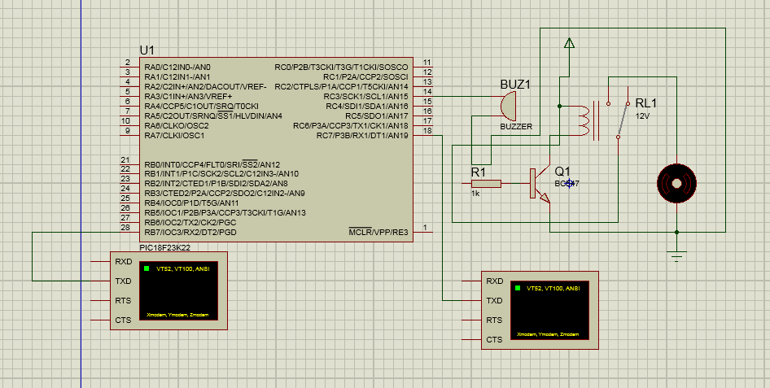
Circuit Diagram:

Slide 6
Circuit Diagram Explanation:
Finger print sensor and RFID module were connected to two uart ports of pic controller ,that is used to gathering user finger print and used unique id
The relay and dc motor is connected to gpio pin and also alarm unit is connected to gpio pin for making alert.

Slide 7
Advantages:
No need to carry the keys to open the lock. Or even there is no need to remember the password or any Pin number.
One of the main advantages is that this system remembers the stored password even if the power supply is turned off.
Scientific research and studies have proved that fingerprints do not change as you grow up.

Slide 8
Applications:
Industrial application
Home or domestic application
Bank Lockers or security safes

